Slide 1
ECEG-5193: Algorithm Analysis and Design
Analysis of Sorting and Searching algorithms
Analysis of Heap Sort

Slide 2
Assignment
Trees
BST
AVL Trees
Red Black Trees
Due
Next Week.
Monday Dec. 11. 2022

Slide 3
Introduction to Binary Heap

Slide 4
Binary heap
A binary tree where the value of a parent is greater than or equal to the value of it’s children
Additional restriction: all levels of the tree are complete except the last
Max heap vs. min heap

Slide 5
Complete Binary Tree
The next nodes
always fill the next
level from left-to-right.
Notes:
...from left-to-right...

Slide 6
Complete Binary Tree
The next nodes
always fill the next
level from left-to-right.
Notes:
...from left-to-right...

Slide 7
Heaps
Complete binary tree.
Notes:
...and when a level is filled you start the next level at the left.

Slide 8
Heaps
A heap is a certain kind of complete binary tree.
45
35
23
27
21
22
4
19
Each node in a heap
contains a key that
can be compared to
other nodes' keys.
Notes:
So, a heap is a complete binary tree. Each node in a heap contains a key, and these keys must be organized in a particular manner. Notice that this is not a binary search tree, but the keys do follow some semblance of order.
Can you see what rule is being enforced here?

Slide 9
Heaps
45
A heap is a certain kind of complete binary tree.
Can be used to store priority queue
35
23
27
21
22
4
19
The "heap property"
requires that each
node's key is >= the
keys of its children
Notes:
The heap property requires that each node's key is >= to the keys of its children.
This is a handy property because the biggest node is always at the top. Because of this, a heap can easily implement a priority queue (where we need quick access to the highest priority item).

Slide 10
Adding a Node to a Heap
Put the new node in the next available spot.
Push the new node upward, swapping with its parent until the new node reaches an acceptable location.
45
35
23
27
21
22
4
19
42
Notes:
We can add new elements to a heap whenever we like. Because the heap is a complete binary search tree, we must add the new element at the next available location, filling in the levels from left-to-right.
In this example, I have just added the new element with a key of 42.
Of course, we now have a problem: The heap property is no longer valid. The 42 is bigger than its parent 27.
To fix the problem, we will push the new node upwards until it reaches an acceptable location.

Slide 11
Adding a Node to a Heap
Put the new node in the next available spot.
Push the new node upward, swapping with its parent until the new node reaches an acceptable location.
45
35
23
42
21
22
4
19
27
Notes:
Here we have pushed the 42 upward one level, swapping it with its smaller parent 27.
We can't stop here though, because the parent 35 is still smaller than the new node 42.

Slide 12
Adding a Node to a Heap
Put the new node in the next available spot.
Push the new node upward, swapping with its parent until the new node reaches an acceptable location.
45
42
23
35
21
22
4
19
27
Notes:
Can we stop now? Yes, because the 42 is less than or equal to its parent.

Slide 13
Adding a Node to a Heap
The parent has a key that is ≥ new node, or
The node reaches the root.
The process of pushing the new node upward is called reheapification upward.
45
42
23
35
21
22
4
19
27
Notes:
In general, there are two conditions that can stop the pushing upward:
1. We reach a spot where the parent is >= the new node, or
2. We reach the root.
This process is called reheapification upward (I didn't just make up that name, really).

Slide 14
Removing the Top of a Heap
45
Move the last node onto the root.
42
23
35
21
22
4
19
27
Notes:
We can also remove the top node from a heap. The first step of the removal is to move the last node of the tree onto the root. In this example we move the 27 onto the root.

Slide 15
Removing the Top of a Heap
27
Move the last node onto the root.
42
23
35
21
22
4
19
Notes:
Now the 27 is on top of the heap, and the original root (45) is no longer around. But the heap property is once again violated.

Slide 16
Removing the Top of a Heap
27
Move the last node onto the root.
Push the out-of-place node downward, swapping with its larger child until the new node reaches an acceptable location.
42
23
35
21
22
4
19
Notes:
We'll fix the problem by pushing the out-of-place node downward. Perhaps you can guess what the downward pushing is called....reheapification downward.

Slide 17
Removing the Top of a Heap
Move the last node onto the root.
Push the out-of-place node downward, swapping with its larger child until the new node reaches an acceptable location.
42
27
23
35
21
22
4
19
Notes:
When we push a node downward it is important to swap it with its largest child. (Otherwise we are creating extra problems by placing the smaller child on top of the larger child.) This is what the tree looks like after one swap.
Should I continue with the reheapification downward?

Slide 18
Removing the Top of a Heap
42
Move the last node onto the root.
Push the out-of-place node downward, swapping with its larger child until the new node reaches an acceptable location.
35
23
27
21
22
4
19
Notes:
Yes, I swap again, and now the 27 is in an acceptable location.

Slide 19
Removing the Top of a Heap
42
The children all have keys ≤ the out-of-place node, or
The node reaches the leaf.
35
23
27
21
22
4
19
The process of pushing the new node downward is called reheapification downward.
Notes:
Reheapification downward can stop under two circumstances:
1. The children all have keys that are <= the out-of-place node.
2. The out-of-place node reaches a leaf.

Slide 20
Implementing a Heap
42
We will store the data from the nodes in a partially-filled array.
35
23
27
21
An array of data
Notes:
This slide shows the typical way that a heap is implemented. For the most part, there is nothing new here, because you already know how to implement a complete binary tree using a partially-filled array. That is what we are doing with the heap.

Slide 21
Implementing a Heap
Data from the root goes in the first location of the array.
42
35
23
27
21
42
An array of data
Notes:
Following the usual technique for implementing a complete binary tree, the data from the root is stored in the first entry of the array.

Slide 22
Implementing a Heap
42
Data from the next row goes in the next two array locations.
35
23
27
21
42
35
23
An array of data
Notes:
The next two nodes go in the next two locations of the array.

Slide 23
Implementing a Heap
42
Data from the next row goes in the next two array locations.
35
23
27
21
42
35
23
27
21
An array of data
Notes:
and so on.

Slide 24
Implementing a Heap
42
Data from the next row goes in the next two array locations.
35
23
27
21
42
35
23
27
21
An array of data
We don't care what's in
this part of the array.
Notes:
As with any partially-filled array, we are only concerned with the front part of the array. If the tree has five nodes, then we are only concerned with the entries in the first five components of the array.

Slide 25
Important Points about the Implementation
The links between the tree's nodes are not actually stored as pointers, or in any other way.
The only way we "know" that "the array is a tree" is from the way we manipulate the data.
42
35
23
27
21
42
35
23
27
21
An array of data
Notes:
With this implementation of a heap, there are no pointers. The only way that we know that the array is a heap is the manner in which we manipulate it.

Slide 26
Binary heap - operations
Maximum(S)
return the largest element in the set
ExtractMax(S)
return and remove the largest element in the set
Insert(S, val)
insert val into the set
IncreaseElement(S, x, val)
increase the value of element x to val
BuildHeap(A)
build a heap from an array of elements

Slide 27
Binary heap - pointers
all nodes in a heap are themselves heaps
16
parent ≥ child
complete tree
14
10
8
7
9
3
2
4
1
level does not indicate size

Slide 28
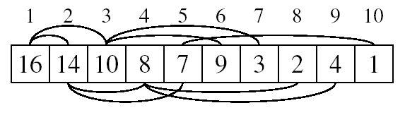
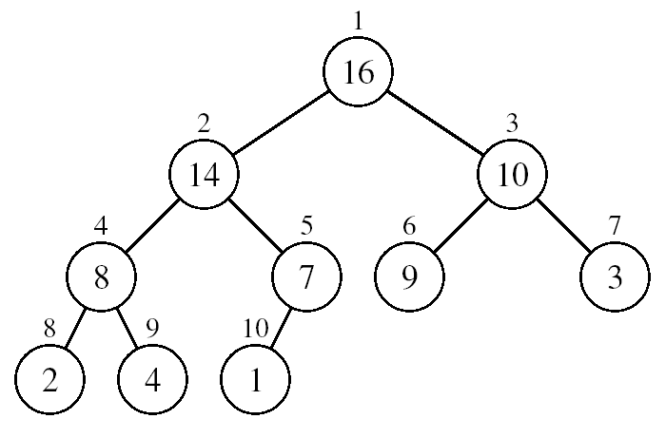
Array Representation of Heaps
A heap can be stored as an array A.
Root of tree is A[1]
Left child of A[i] = A[2i]
Right child of A[i] = A[2i + 1]
Parent of A[i] = A[ ⎣i/2⎦ ]
Heapsize[A] ≤ length[A]
The elements in the subarray A[(⎣n/2⎦+1) .. n] are leaves

Slide 29
Heap Types
Max-heaps (largest element at root), have the max-heap property:
for all nodes i, excluding the root:
A[PARENT(i)] ≥ A[i]
Min-heaps (smallest element at root), have the min-heap property:
for all nodes i, excluding the root:
A[PARENT(i)] ≤ A[i]

Slide 30



Binary heap - array
16 | 14 | 10 | 8 | 7 | 9 | 3 | 2 | 4 | 1
1 | 2 | 3 | 4 | 5 | 6 | 7 | 8 | 9 | 10
$$Parent\left(i\right)= \left\lfloor \frac{i}{2}\right\rfloor$$
$$Left\left(i\right)=2i$$
$$Left\left(i\right)=2i+1$$

Slide 31

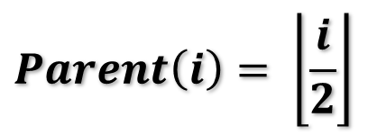

Binary heap - array
16 | 14 | 10 | 8 | 7 | 9 | 3 | 2 | 4 | 1
1 | 2 | 3 | 4 | 5 | 6 | 7 | 8 | 9 | 10
$$Parent\left(i\right)= \left\lfloor \frac{i}{2}\right\rfloor$$
Left child of A[3]?
= 2*i
$$Left\left(i\right)=2i$$
= 2*3
= 6
$$Left\left(i\right)=2i+1$$

Slide 32
Binary heap - array
16 | 14 | 10 | 8 | 7 | 9 | 3 | 2 | 4 | 1
1 | 2 | 3 | 4 | 5 | 6 | 7 | 8 | 9 | 10
$$Parent\left(i\right)= \left\lfloor \frac{i}{2}\right\rfloor$$
Left child of A[3]?
= 2*i
$$Left\left(i\right)=2i$$
= 2*3
= 6
$$Left\left(i\right)=2i+1$$

Slide 33
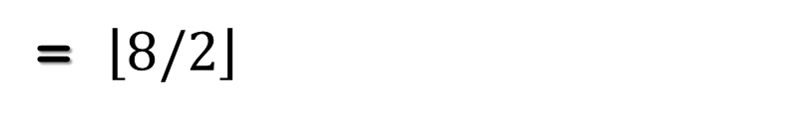
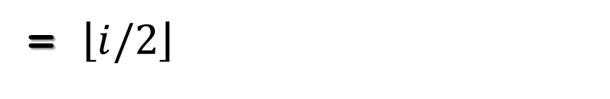
Binary heap - array
16 | 14 | 10 | 8 | 7 | 9 | 3 | 2 | 4 | 1
1 | 2 | 3 | 4 | 5 | 6 | 7 | 8 | 9 | 10
$$Parent\left(i\right)= \left\lfloor \frac{i}{2}\right\rfloor$$
Parent of A[8]?
= $\left\lfloor i/2\right\rfloor$
$$Left\left(i\right)=2i$$
= $\left\lfloor 8/2\right\rfloor$
= 4
$$Left\left(i\right)=2i+1$$

Slide 34
Binary heap - array
16 | 14 | 10 | 8 | 7 | 9 | 3 | 2 | 4 | 1
1 | 2 | 3 | 4 | 5 | 6 | 7 | 8 | 9 | 10
16
14
10
8
7
9
3
2
4
1

Slide 35
Identify the valid heaps
[15, 12, 3, 11, 10, 2, 1, 7, 8]
16
10
15
9
3
8
[20, 18, 10, 17, 16, 15, 9, 14, 13]

Slide 36
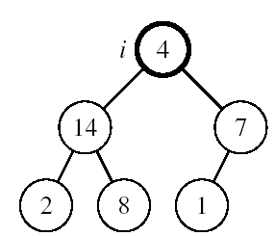
Maintaining the Heap Property
Suppose a node is smaller than a child
Left and Right subtrees of i are max-heaps
To eliminate the violation:
Exchange with larger child
Move down the tree
Continue until node is not smaller than children

Slide 37
Heapify
Assume left and right children are heaps, turn current set into a valid heap
Heapify(A, i)
1 l ← Left(i)
2 r ← Right(i)
3 largest ← i
4 if l ≤ heap-size[A] and A[l] > A[i]
5 largest ← l
6 if r ≤ heap-size[A] and A[r] > A[largest]
7 largest ← r
8 if largest ≠ i
9 swap A[i] and A[largest]
10 Heapify(A, largest)
Get the largest:
current
left
right
if a child is larger, swap and recurse

Slide 38
Binary heap - array
left = 2i = 1*2 = 2
16 | 3 | 10 | 8 | 7 | 9 | 5 | 2 | 4 | 1
1 | 2 | 3 | 4 | 5 | 6 | 7 | 8 | 9 | 10
16
3
10
right = 2i +1 = 3
16
3
10

Slide 39
Binary heap - array
16 | 3 | 10 | 8 | 7 | 9 | 5 | 2 | 4 | 1
1 | 2 | 3 | 4 | 5 | 6 | 7 | 8 | 9 | 10
16
3
10
8
7
9
5
2
4
1

Slide 40
Binary heap - array
16 | 3 | 10 | 8 | 7 | 9 | 5 | 2 | 4 | 1
1 | 2 | 3 | 4 | 5 | 6 | 7 | 8 | 9 | 10
16
3
10
8
7
9
5
2
4
1

Slide 41
Binary heap - array
16 | 3 | 10 | 8 | 7 | 9 | 5 | 2 | 4 | 1
1 | 2 | 3 | 4 | 5 | 6 | 7 | 8 | 9 | 10
Heapify(A, i)
1 l ← Left(i)
2 r ← Right(i)
3 largest ← i
4 if l ≤ heap-size[A] and A[l] > A[i]
5 largest ← l
6 if r ≤ heap-size[A] and A[r] > A[largest]
7 largest ← r
8 if largest ≠ i
9 swap A[i] and A[largest]
10 Heapify(A, largest)
16
3
10
8
7
9
5
2
4
1

Slide 42
Binary heap - array
16 | 3 | 10 | 8 | 7 | 9 | 5 | 2 | 4 | 1
1 | 2 | 3 | 4 | 5 | 6 | 7 | 8 | 9 | 10
Heapify(A, i)
1 l ← Left(i)
2 r ← Right(i)
3 largest ← i
4 if l ≤ heap-size[A] and A[l] > A[i]
5 largest ← l
6 if r ≤ heap-size[A] and A[r] > A[largest]
7 largest ← r
8 if largest ≠ i
9 swap A[i] and A[largest]
10 Heapify(A, largest)
16
8
3
3
10
3
7
8
8
7
9
5
2
4
1

Slide 43
Binary heap - array
16 | 8 | 10 | 3 | 7 | 9 | 5 | 2 | 4 | 1
1 | 2 | 3 | 4 | 5 | 6 | 7 | 8 | 9 | 10
Heapify(A, i)
1 l ← Left(i)
2 r ← Right(i)
3 largest ← i
4 if l ≤ heap-size[A] and A[l] > A[i]
5 largest ← l
6 if r ≤ heap-size[A] and A[r] > A[largest]
7 largest ← r
8 if largest ≠ i
9 swap A[i] and A[largest]
10 Heapify(A, largest)
16
8
10
3
7
9
5
2
4
1

Slide 44
Binary heap - array
16 | 8 | 10 | 3 | 7 | 9 | 5 | 2 | 4 | 1
1 | 2 | 3 | 4 | 5 | 6 | 7 | 8 | 9 | 10
Heapify(A, i)
1 l ← Left(i)
2 r ← Right(i)
3 largest ← i
4 if l ≤ heap-size[A] and A[l] > A[i]
5 largest ← l
6 if r ≤ heap-size[A] and A[r] > A[largest]
7 largest ← r
8 if largest ≠ i
9 swap A[i] and A[largest]
10 Heapify(A, largest)
16
8
10
3
7
9
5
4
2
4
1
3

Slide 45
Binary heap - array
16 | 8 | 10 | 3 | 7 | 9 | 5 | 2 | 4 | 1
1 | 2 | 3 | 4 | 5 | 6 | 7 | 8 | 9 | 10
Heapify(A, i)
1 l ← Left(i)
2 r ← Right(i)
3 largest ← i
4 if l ≤ heap-size[A] and A[l] > A[i]
5 largest ← l
6 if r ≤ heap-size[A] and A[r] > A[largest]
7 largest ← r
8 if largest ≠ i
9 swap A[i] and A[largest]
10 Heapify(A, largest)
16
8
10
4
7
9
5
2
3
1

Slide 46
Correctness of Heapify
8 if largest ≠ i
9 swap A[i] and A[largest]
10 Heapify(A, largest)
Remember both the children are valid heaps
Case 1: A[i] (current node) is the largest
parent is greater than both children
both children are heaps
current node is a valid heap

Slide 47
Correctness of heapify
8 if largest ≠ i
9 swap A[i] and A[largest]
10 Heapify(A, largest)
Case 2: left child is the largest
When Heapify returns:
Left child is a valid heap
Right child is unchanged and therefore a valid heap
Current node is larger than both children since we selected the largest node of current, left and right
current node is a valid heap
Case 3: right child is largest
similar to above

Slide 48


Running time of Heapify
Heapify(A, i)
1 l ← Left(i)
2 r ← Right(i)
3 largest ← i
4 if l ≤ heap-size[A] and A[l] > A[i]
5 largest ← l
6 if r ≤ heap-size[A] and A[r] > A[largest]
7 largest ← r
8 if largest ≠ i
9 swap A[i] and A[largest]
10 Heapify(A, largest)
What is the cost of each call to Heapify?
Θ(1)
How many calls are made to Heapify?
O(height of the tree)
What is the height of the tree?
Complete binary tree, except for the last level
$$2^{h}≤n$$
$$h≤\log_{2}{n}$$
O(log n)

Slide 49
Binary heap - operations
Maximum(S) - return the largest element in the set
ExtractMax(S) – Return and remove the largest element in the set
Insert(S, val) – insert val into the set
IncreaseElement(S, x, val) – increase the value of element x to val
BuildHeap(A) – build a heap from an array of elements

Slide 50
Maximum
Return the largest element from the set
Return A[1]
16 14 10 8 7 9 3 2 4 1
1 2 3 4 5 6 7 8 9 10

Slide 51
ExtractMax
Return and remove the largest element in the set
16
14
10
8
7
9
3
2
4
1

Slide 52
ExtractMax
Return and remove the largest element in the set
?
14
10
8
7
9
3
2
4
1

Slide 53
ExtractMax
Return and remove the largest element in the set
14
?
10
8
7
9
3
2
4
1

Slide 54
ExtractMax
Return and remove the largest element in the set
14
8
10
4
7
9
3
?
2
1

Slide 55
ExtractMax
Return and remove the largest element in the set
16
14
10
8
7
9
3
2
4
1

Slide 56
ExtractMax
Return and remove the largest element in the set
?
14
10
8
7
9
3
2
4
1

Slide 57
ExtractMax
Return and remove the largest element in the set
1
14
10
8
7
9
3
2
4

Slide 58
ExtractMax
Return and remove the largest element in the set
Heapify
1
14
10
8
7
9
3
2
4

Slide 59
ExtractMax
Return and remove the largest element in the set
Extract-Max(A, i)
1 if heap-size[A] < 1
2 error
3 max = A[1]
4 A[1] ← A[heap-size[A]] - 1
5 heap-size[A] ← heap-size[A] -1
6 Heapify(A, 1)
7 return max

Slide 60
ExtractMax running time
Extract-Max(A, i)
1 if heap-size[A] < 1
2 error
3 max = A[1]
4 A[1] ← A[Heap-Size[A]] - 1
5 heap-size[A] ← heap-size[A] -1
6 Heapify(A, 1)
7 return max
Constant amount of work plus one call to Heapify
– O(log n)

Slide 61
IncreaseElement
Increase the value of element x to val
16
14
10
8
7
9
3
2
4
1
15

Slide 62
IncreaseElement
Increase the value of element x to val
16
14
10
8
7
9
3
2
15
1

Slide 63
IncreaseElement
Increase the value of element x to val
16
14
10
15
7
9
3
2
8
1

Slide 64
IncreaseElement
Increase the value of element x to val
16
14
10
15
7
9
3
2
8
1

Slide 65
IncreaseElement
Increase the value of element x to val
16
15
10
14
7
9
3
2
8
1

Slide 66
IncreaseElement
Increase the value of element x to val
Increase-Element(A, i, val)
1 if val <A[i]
2 error
3 A[i] ← val
4 while i >1 and A[Parent(i)]<A[i]
5 swap A[i] and A[Parent(i)]
6 i ← Parent(i)

Slide 67
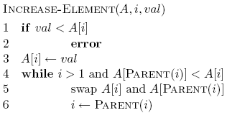
Correctness of IncreaseElement
Why is it ok to swap values with parent?

Slide 68
Correctness of IncreaseElement
Stop when heap property is satisfied

Slide 69
Running time of IncreaseElement
Follows a path from a node to the root
Worst case O(height of the tree)
O(log n)

Slide 70
Insert
Insert val into the set
16
14
10
6
8
7
9
3
2
4
1

Slide 71
Insert
Insert val into the set
16
14
10
8
7
9
3
2
4
1
6

Slide 72
Insert
Insert val into the set
16
14
10
8
7
9
3
propagate value up
2
4
1
6

Slide 73
Insert
Insert(A, val)
1 if heap-size[A] ← heap-size[A] +1
2 A[heap-size[A]] ← -ꝏ
3 Increase-Element(A, heap-size[A], val)

Slide 74
Running time of Insert
Constant amount of work plus one call to IncreaseElement – O(log n)
Insert(A, val)
1 if heap-size[A] ← heap-size[A] +1
2 A[heap-size[A]] ← -ꝏ
3 Increase-Element(A, heap-size[A], val)

Slide 75
Building a heap
Can we build a heap using the functions we have so far?
Maximum(S)
ExtractMax(S)
Insert(S, val)|
IncreaseElement(S, x, val)

Slide 76
Building a heap
Build-Heap(A)
1 copy A to B
2 heap-size[A] ← 0
3 for i ← 1 to length[B]
4 Insert(A, B[i]))

Slide 77
Running time of BuildHeap1
n calls to Insert – O(n log n)
Can we get a better bound?
…

Slide 78
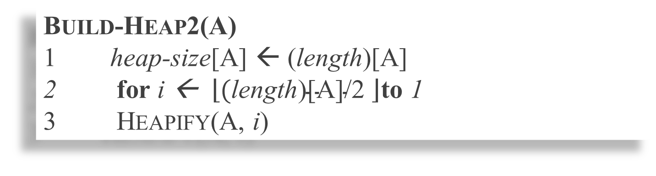
Building a heap: take 2
Build-Heap2(A)
1 heap-size[A] ← (length)[A]
2 for i ← $\left\lfloor \text{(}\text{length}\text{)}\text{[}\text{A}\text{]/2 }\right\rfloor$to 1
3 Heapify(A, i)
Start with n/2 “simple” heaps
call Heapify on element n/2-1, n/2-2, n/2-3 …
all children have smaller indices
building from the bottom up, makes sure that all the children are heaps

Slide 79
Example: A
4 | 1 | 3 | 2 | 16 | 9 | 10 | 14 | 8 | 7
i = 5
i = 4
i = 3
1
1
1
4
4
4
2
3
2
3
2
3
1
3
1
3
1
3
4
5
6
7
4
5
6
7
4
5
6
7
2
16
9
10
2
16
9
10
14
16
9
10
8
9
10
8
9
10
8
9
10
14
8
7
14
8
7
2
8
7
i = 2
i = 1
1
1
1
4
4
16
2
3
2
3
2
3
1
10
16
10
14
10
4
5
6
7
4
5
6
7
4
5
6
7
14
16
9
3
14
7
9
3
8
7
9
3
8
9
10
8
9
10
8
9
10
2
8
7
2
8
1
2
4
1

Slide 80
4 1 3 2 16 9 10 14 8 7
1 2 3 4 5 6 7 8 9 10
4
1
3
2
16
9
10
14
8
7

Slide 81
heapify
4 1 3 2 16 9 10 14 8 7
1 2 3 4 5 6 7 8 9 10
4
1
3
2
16
9
10
14
8
7

Slide 82
heapify
4 1 3 2 16 9 10 14 8 7
1 2 3 4 5 6 7 8 9 10
4
1
3
2
16
9
10
14
8
7

Slide 83
heapify
4 1 3 14 16 9 10 2 8 7
1 2 3 4 5 6 7 8 9 10
4
1
3
14
16
9
10
2
8
7

Slide 84
heapify
4 1 3 14 16 9 10 2 8 7
1 2 3 4 5 6 7 8 9 10
4
1
3
14
16
9
10
2
8
7

Slide 85
heapify
4 1 10 14 16 9 3 2 8 7
1 2 3 4 5 6 7 8 9 10
4
1
10
14
16
9
3
2
8
7

Slide 86
heapify
4 1 10 14 16 9 3 2 8 7
1 2 3 4 5 6 7 8 9 10
4
1
10
14
16
9
3
2
8
7

Slide 87
heapify
4 16 10 14 7 9 3 2 8 1
1 2 3 4 5 6 7 8 9 10
4
16
10
14
7
9
3
2
8
1

Slide 88
heapify
4 16 10 14 7 9 3 2 8 1
1 2 3 4 5 6 7 8 9 10
4
16
10
14
7
9
3
2
8
1

Slide 89
heapify
16 14 10 8 7 9 3 2 4 1
1 2 3 4 5 6 7 8 9 10
16
14
10
8
7
9
3
2
4
1

Slide 90
Correctness of BuildHeap2
Invariant: elements A[i +1…n] are all heaps
Base case: i = floor(n/2). All elements i+1, i+2, …, n are “simple” heaps
Inductive case: We know i+1, i+2, .., n are all heaps, therefore the call to Heapify(A,i) generates a heap at node i
Termination?

Slide 91
Running time of BuildHeap2
n/2 calls to Heapify – O(n log n)
Can we get a tighter bound?

Slide 92
Running time of BuildHeap2
16
14
10
all nodes at the same level will have the same cost
8
7
9
3
2
4
1
How many nodes are at level d?
2^{d}

Slide 93
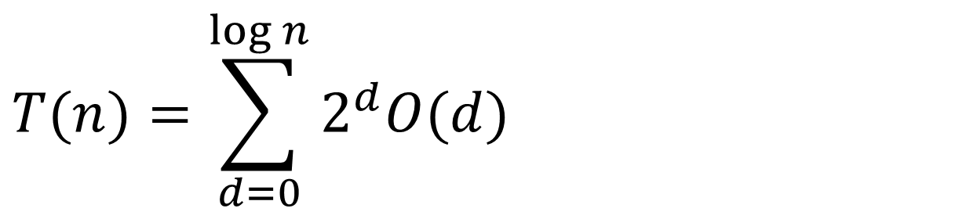
Running time of BuildHeap2
$$T(n)=\sum_{d=0}^{\log{n}}{2^{d}O(d)}$$
?

Slide 94
Nodes at height h
h
< ceil(n/2^{h+1}) nodes
h=2
< ceil(n/8) nodes
h=1
< ceil(n/4) nodes
h=0
< ceil(n/2) nodes

Slide 95
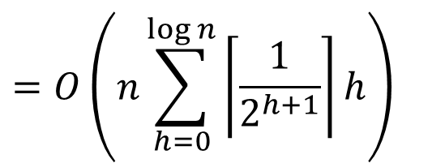

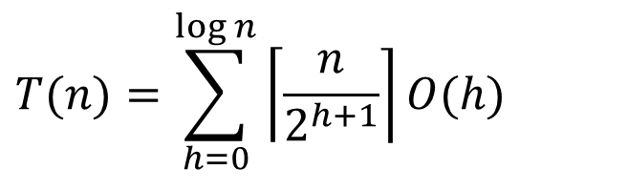
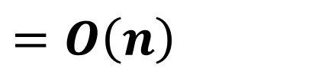


Running time of BuildHeap2
$$T(n)=\sum_{h=0}^{\log{n}}{\left\lceil \frac{n}{2^{h+1}}\right\rceil O(h)}$$
$$=O\left(n\sum_{h=0}^{∞}{\frac{h}{2^{h}}}\right)$$
$$=O\left(n\sum_{h=0}^{\log{n}}{\left\lceil \frac{1}{2^{h+1}}\right\rceil h}\right)$$
$$\sum_{h=0}^{∞}{\frac{h}{2^{h}}=\frac{1/2}{(1−1/2)^{2}}=2}$$
$$=O\left(n\sum_{h=0}^{\log{n}}{\frac{h}{2^{h}}}\right)$$
$$=O\left(n\right)$$

Slide 96
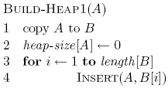

BuildHeap1 vs. BuildHeap2
Runtime
Both O(n)
BuildHeap2 may have smaller constants (only n/2 calls)
Memory
Both O(n)
BuildHeap1 requires an additional array, i.e. 2n memory
Complexity/Ease of implementation

Slide 97
Running Time of BUILD MAX HEAP
BUILD-MAX-HEAP(A)
n = length[A]
for i ← ⎣n/2⎦ downto 1
do MAX-HEAPIFY(A, i, n)
O(n)
O(lgn)
⇒ Running time: O(nlgn)
This is not an asymptotically tight upper bound

Slide 98
Running Time of BUILD MAX HEAP
HEAPIFY takes O(h) ⇒ the cost of HEAPIFY on a node i is proportional to the height of the node i in the tree
Height
Level
No. of nodes
h₀ = 3 (⎣lgn⎦)
i = 0
2⁰
h₁ = 2
i = 1
2¹
h₂ = 1
i = 2
2²
h₃ = 0
i = 3 (⎣lgn⎦)
2³
h_{i} = h – i height of the heap rooted at level i
n_{i} = 2^{i} number of nodes at level i

Slide 99
Running Time of BUILD MAX HEAP
Cost of HEAPIFY at level i ∗ number of nodes at that level
Replace the values of n_{i} and h_{i} computed before
Multiply by 2^{h} both at the nominator and denominator and
write 2^{i} as
Change variables: k = h - i
The sum above is smaller than the sum of all elements to ∞
and h = lgn
The sum above is smaller than 2
Running time of BUILD-MAX-HEAP: T(n) = O(n)

Slide 100
Heap uses
Heapsort
Build a heap
Call ExtractMax for all the elements
O(n log n) running time
Priority queues
scheduling tasks: jobs, processes, network traffic
A* search algorithm

Slide 101
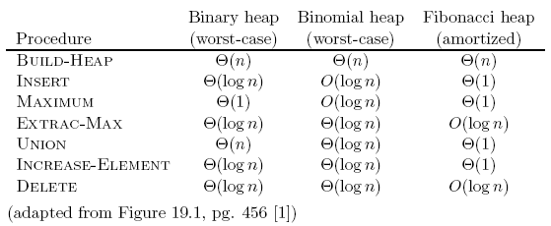
Other heaps

Slide 102
Other heaps

Slide 103
Other heaps

Slide 104
Heapsort

Slide 105
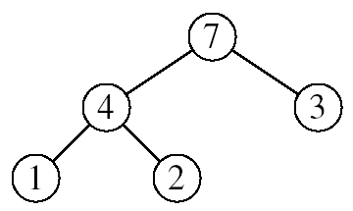
Heapsort
Goal:
Sort an array using heap representations
Idea:
Build a max-heap from the array
Swap the root (the maximum element) with the last element in the array
“Discard” this last node by decreasing the heap size
Call MAX-HEAPIFY on the new root
Repeat this process until only one node remains

Slide 106
Example: A=[7, 4, 3, 1, 2]
Swap the root (MAX) with the last element in the array
“Discard” this last node by decreasing the heap size
Call MAX-HEAPIFY on the new root
Repeat this process until only one node remains
2
7
7
4
3
1
2
2
7
7 | 4 | 3 | 1 | 2

Slide 107
Example: A=[7, 4, 3, 1, 2]
Swap the root (MAX) with the last element in the array
“Discard” this last node by decreasing the heap size
Call MAX-HEAPIFY on the new root
Repeat this process until only one node remains
2
4
3
1
7
2 | 4 | 3 | 1 | 7

Slide 108
Example: A=[7, 4, 3, 1, 2]
Swap the root (MAX) with the last element in the array
“Discard” this last node by decreasing the heap size
Call MAX-HEAPIFY on the new root
Repeat this process until only one node remains
2
4
3
1
2 | 4 | 3 | 1 | 7

Slide 109
Example: A=[7, 4, 3, 1, 2]
Swap the root (MAX) with the last element in the array
“Discard” this last node by decreasing the heap size
Call MAX-HEAPIFY on the new root
Repeat this process until only one node remains
4
2
3
1
2 | 4 | 3 | 1 | 7

Slide 110
Example: A=[7, 4, 3, 1, 2]
Swap the root (MAX) with the last element in the array
“Discard” this last node by decreasing the heap size
Call MAX-HEAPIFY on the new root
Repeat this process until only one node remains
4
2
3
1
1
2 | 4 | 3 | 1 | 7

Slide 111
Example: A=[7, 4, 3, 1, 2]
Swap the root (MAX) with the last element in the array
“Discard” this last node by decreasing the heap size
Call MAX-HEAPIFY on the new root
Repeat this process until only one node remains
1
2
3
1
4
1 | 4 | 3 | 4 | 7

Slide 112
Example: A=[7, 4, 3, 1, 2]
Swap the root (MAX) with the last element in the array
“Discard” this last node by decreasing the heap size
Call MAX-HEAPIFY on the new root
Repeat this process until only one node remains
1
2
3
4
1 | 4 | 3 | 4 | 7

Slide 113
Example: A=[7, 4, 3, 1, 2]
Swap the root (MAX) with the last element in the array
“Discard” this last node by decreasing the heap size
Call MAX-HEAPIFY on the new root
Repeat this process until only one node remains
1
2
3
2 | 1 | 3 | 4 | 7

Slide 114
Example: A=[7, 4, 3, 1, 2]
Swap the root (MAX) with the last element in the array
“Discard” this last node by decreasing the heap size
Call MAX-HEAPIFY on the new root
Repeat this process until only one node remains
1
2
3
2 | 1 | 3 | 4 | 7

Slide 115
Example: A=[7, 4, 3, 1, 2]
Swap the root (MAX) with the last element in the array
“Discard” this last node by decreasing the heap size
Call MAX-HEAPIFY on the new root
Repeat this process until only one node remains
3
2
1
3 | 2 | 1 | 4 | 7

Slide 116
Example: A=[7, 4, 3, 1, 2]
Swap the root (MAX) with the last element in the array
“Discard” this last node by decreasing the heap size
Call MAX-HEAPIFY on the new root
Repeat this process until only one node remains
3
2
1
3 | 2 | 1 | 4 | 7

Slide 117
Example: A=[7, 4, 3, 1, 2]
Swap the root (MAX) with the last element in the array
“Discard” this last node by decreasing the heap size
Call MAX-HEAPIFY on the new root
Repeat this process until only one node remains
1
2
3
1 | 2 | 3 | 4 | 7

Slide 118
Example: A=[7, 4, 3, 1, 2]
Swap the root (MAX) with the last element in the array
“Discard” this last node by decreasing the heap size
Call MAX-HEAPIFY on the new root
Repeat this process until only one node remains
1
2
3
1 | 2 | 3 | 4 | 7

Slide 119
Example: A=[7, 4, 3, 1, 2]
Swap the root (MAX) with the last element in the array
“Discard” this last node by decreasing the heap size
Call MAX-HEAPIFY on the new root
Repeat this process until only one node remains
1
2
1 | 2 | 3 | 4 | 7

Slide 120
Example: A=[7, 4, 3, 1, 2]
Swap the root (MAX) with the last element in the array
“Discard” this last node by decreasing the heap size
Call MAX-HEAPIFY on the new root
Repeat this process until only one node remains
1
2
1 | 2 | 3 | 4 | 7

Slide 121
Example: A=[7, 4, 3, 1, 2]
Swap the root (MAX) with the last element in the array
“Discard” this last node by decreasing the heap size
Call MAX-HEAPIFY on the new root
Repeat this process until only one node remains
1
2
1 | 2 | 3 | 4 | 7

Slide 122
Example: A=[7, 4, 3, 1, 2]
Swap the root (MAX) with the last element in the array
“Discard” this last node by decreasing the heap size
Call MAX-HEAPIFY on the new root
Repeat this process until only one node remains
1
2
1 | 2 | 3 | 4 | 7

Slide 123
Example: A=[7, 4, 3, 1, 2]
Swap the root (MAX) with the last element in the array
“Discard” this last node by decreasing the heap size
Call MAX-HEAPIFY on the new root
Repeat this process until only one node remains
2
1
2 | 1 | 3 | 4 | 7

Slide 124
Example: A=[7, 4, 3, 1, 2]
Swap the root (MAX) with the last element in the array
“Discard” this last node by decreasing the heap size
Call MAX-HEAPIFY on the new root
Repeat this process until only one node remains
2
1
2 | 1 | 3 | 4 | 7

Slide 125
Example: A=[7, 4, 3, 1, 2]
Swap the root (MAX) with the last element in the array
“Discard” this last node by decreasing the heap size
Call MAX-HEAPIFY on the new root
Repeat this process until only one node remains
2
1
2 | 1 | 3 | 4 | 7

Slide 126
Example: A=[7, 4, 3, 1, 2]
Swap the root (MAX) with the last element in the array
“Discard” this last node by decreasing the heap size
Call MAX-HEAPIFY on the new root
Repeat this process until only one node remains
1
2
1 | 2 | 3 | 4 | 7

Slide 127
Example: A=[7, 4, 3, 1, 2]
Swap the root (MAX) with the last element in the array
“Discard” this last node by decreasing the heap size
Call MAX-HEAPIFY on the new root
Repeat this process until only one node remains
1
2
1 | 2 | 3 | 4 | 7

Slide 128
Example: A=[7, 4, 3, 1, 2]
Swap the root (MAX) with the last element in the array
“Discard” this last node by decreasing the heap size
Call MAX-HEAPIFY on the new root
Repeat this process until only one node remains
1
2
1 | 2 | 3 | 4 | 7

Slide 129
Example: A=[7, 4, 3, 1, 2]
Swap the root (MAX) with the last element in the array
“Discard” this last node by decreasing the heap size
Call MAX-HEAPIFY on the new root
Repeat this process until only one node remains
1
1 | 2 | 3 | 4 | 7

Slide 130
Example: A=[7, 4, 3, 1, 2]
Swap the root (MAX) with the last element in the array
“Discard” this last node by decreasing the heap size
Call MAX-HEAPIFY on the new root
Repeat this process until only one node remains
1 | 2 | 3 | 4 | 7

Slide 131
Example: A=[7, 4, 3, 1, 2]
Swap the root (MAX) with the last element in the array
“Discard” this last node by decreasing the heap size
Call MAX-HEAPIFY on the new root
Repeat this process until only one node remains
1
1 | 2 | 3 | 4 | 7

Slide 132
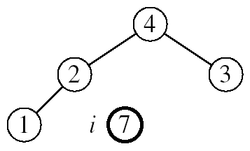
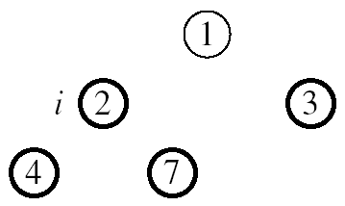
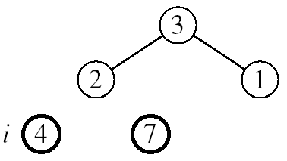
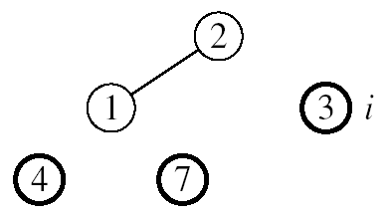

Example: A=[7, 4, 3, 1, 2]
MAX-HEAPIFY(A, 1, 4)
MAX-HEAPIFY(A, 1, 3)
MAX-HEAPIFY(A, 1, 2)
MAX-HEAPIFY(A, 1, 1)

Slide 133
HEAPSORT(A)
BUILD-MAX-HEAP(A)
for i ← length[A] downto 2
do exchange A[1] ↔ A[i]
MAX-HEAPIFY(A, 1, i - 1)
Running time: O(nlgn) --- Can be shown to be Θ(nlgn)
O(n)
n-1 times
O(lgn)

Slide 134
Heapsort
Demo

Slide 135
Heapsort
45
27
42
21
23
22
35
19
4
5
[0] | [1] | [2] | [3] | [4] | [5] | [6] | [7] | [8] | [9]

Slide 136
45 | 27 | 42 | 21 | 23 | 22 | 35 | 19 | 4 | 5
[0] | [1] | [2] | [3] | [4] | [5] | [6] | [7] | [8] | [9]
5 | 27 | 42 | 21 | 23 | 22 | 35 | 19 | 4 | 45
[0] | [1] | [2] | [3] | [4] | [5] | [6] | [7] | [8] | [9]
42 | 27 | 5 | 21 | 23 | 22 | 35 | 19 | 4 | 45
[0] | [1] | [2] | [3] | [4] | [5] | [6] | [7] | [8] | [9]
42 | 27 | 35 | 21 | 23 | 22 | 5 | 19 | 4 | 45
[0] | [1] | [2] | [3] | [4] | [5] | [6] | [7] | [8] | [9]
For an element in arr[i]: Parent[(i-1)/2]
Left child [2i+1]
Right child [2i+2]

Slide 137
42 | 27 | 35 | 21 | 23 | 22 | 5 | 19 | 4 | 45
[0] | [1] | [2] | [3] | [4] | [5] | [6] | [7] | [8] | [9]
4 | 27 | 35 | 21 | 23 | 22 | 5 | 19 | 42 | 45
[0] | [1] | [2] | [3] | [4] | [5] | [6] | [7] | [8] | [9]
35 | 27 | 4 | 21 | 23 | 22 | 5 | 19 | 42 | 45
[0] | [1] | [2] | [3] | [4] | [5] | [6] | [7] | [8] | [9]
35 | 27 | 22 | 21 | 23 | 4 | 5 | 19 | 42 | 45
[0] | [1] | [2] | [3] | [4] | [5] | [6] | [7] | [8] | [9]
For an element in arr[i]: Parent[(i-1)/2]
Left child [2i+1]
Right child [2i+2]

Slide 138
35 | 27 | 22 | 21 | 23 | 4 | 5 | 19 | 42 | 45
[0] | [1] | [2] | [3] | [4] | [5] | [6] | [7] | [8] | [9]
19 | 27 | 22 | 21 | 23 | 4 | 5 | 35 | 42 | 45
[0] | [1] | [2] | [3] | [4] | [5] | [6] | [7] | [8] | [9]
27 | 19 | 22 | 21 | 23 | 4 | 5 | 35 | 42 | 45
[0] | [1] | [2] | [3] | [4] | [5] | [6] | [7] | [8] | [9]
27 | 23 | 22 | 21 | 19 | 4 | 5 | 35 | 42 | 45
[0] | [1] | [2] | [3] | [4] | [5] | [6] | [7] | [8] | [9]
For an element in arr[i]: Parent[(i-1)/2]
Left child [2i+1]
Right child [2i+2]

Slide 139
27 | 23 | 22 | 21 | 19 | 4 | 5 | 35 | 42 | 45
[0] | [1] | [2] | [3] | [4] | [5] | [6] | [7] | [8] | [9]
5 | 23 | 22 | 21 | 19 | 4 | 27 | 35 | 42 | 45
[0] | [1] | [2] | [3] | [4] | [5] | [6] | [7] | [8] | [9]
23 | 5 | 22 | 21 | 19 | 4 | 27 | 35 | 42 | 45
[0] | [1] | [2] | [3] | [4] | [5] | [6] | [7] | [8] | [9]
23 | 21 | 22 | 5 | 19 | 4 | 27 | 35 | 42 | 45
[0] | [1] | [2] | [3] | [4] | [5] | [6] | [7] | [8] | [9]
For an element in arr[i]: Parent[(i-1)/2]
Left child [2i+1]
Right child [2i+2]

Slide 140
23 | 21 | 22 | 5 | 19 | 4 | 27 | 35 | 42 | 45
[0] | [1] | [2] | [3] | [4] | [5] | [6] | [7] | [8] | [9]
4 | 21 | 22 | 5 | 19 | 23 | 27 | 35 | 42 | 45
[0] | [1] | [2] | [3] | [4] | [5] | [6] | [7] | [8] | [9]
22 | 21 | 4 | 5 | 19 | 23 | 27 | 35 | 42 | 45
[0] | [1] | [2] | [3] | [4] | [5] | [6] | [7] | [8] | [9]
For an element in arr[i]: Parent[(i-1)/2]
Left child [2i+1]
Right child [2i+2]

Slide 141
22 | 21 | 4 | 5 | 19 | 23 | 27 | 35 | 42 | 45
[0] | [1] | [2] | [3] | [4] | [5] | [6] | [7] | [8] | [9]
19 | 21 | 4 | 5 | 22 | 23 | 27 | 35 | 42 | 45
[0] | [1] | [2] | [3] | [4] | [5] | [6] | [7] | [8] | [9]
21 | 19 | 4 | 5 | 22 | 23 | 27 | 35 | 42 | 45
[0] | [1] | [2] | [3] | [4] | [5] | [6] | [7] | [8] | [9]
For an element in arr[i]: Parent[(i-1)/2]
Left child [2i+1]
Right child [2i+2]

Slide 142
21 | 19 | 4 | 5 | 22 | 23 | 27 | 35 | 42 | 45
[0] | [1] | [2] | [3] | [4] | [5] | [6] | [7] | [8] | [9]
5 | 19 | 4 | 21 | 22 | 23 | 27 | 35 | 42 | 45
[0] | [1] | [2] | [3] | [4] | [5] | [6] | [7] | [8] | [9]
19 | 5 | 4 | 21 | 22 | 23 | 27 | 35 | 42 | 45
[0] | [1] | [2] | [3] | [4] | [5] | [6] | [7] | [8] | [9]
For an element in arr[i]: Parent[(i-1)/2]
Left child [2i+1]
Right child [2i+2]

Slide 143
19 | 5 | 4 | 21 | 22 | 23 | 27 | 35 | 42 | 45
[0] | [1] | [2] | [3] | [4] | [5] | [6] | [7] | [8] | [9]
4 | 5 | 19 | 21 | 22 | 23 | 27 | 35 | 42 | 45
[0] | [1] | [2] | [3] | [4] | [5] | [6] | [7] | [8] | [9]
4 | 5 | 19 | 21 | 22 | 23 | 27 | 35 | 42 | 45
[0] | [1] | [2] | [3] | [4] | [5] | [6] | [7] | [8] | [9]
For an element in arr[i]: Parent[(i-1)/2]
Left child [2i+1]
Right child [2i+2]

Slide 144
Priority Queues

Slide 145
Priority Queues
12
4

Slide 146
Operations on Priority Queues
Max-priority queues support the following operations:
INSERT(S, x): inserts element x into set S
EXTRACT-MAX(S): removes and returns element of S with largest key
MAXIMUM(S): returns element of S with largest key
INCREASE-KEY(S, x, k): increases value of element x’s key to k (Assume k ≥ x’s current key value)

Slide 147
HEAP-EXTRACT-MAX
Goal:
Extract the largest element of the heap (i.e., return the max value and also remove that element from the heap
Idea:
Exchange the root element with the last
Decrease the size of the heap by 1 element
Call MAX-HEAPIFY on the new root, on a heap of size n-1
Heap A:
Root is the largest element

Slide 148
Example: HEAP-EXTRACT-MAX
16
1
14
10
max = 16
14
10
8
7
9
3
8
7
9
3
2
4
1
2
4
Heap size decreased with 1
14
Call MAX-HEAPIFY(A, 1, n-1)
8
10
4
7
9
3
2
1

Slide 149
HEAP-EXTRACT-MAX
HEAP-EXTRACT-MAX(A, n)
if n < 1
then error “heap underflow”
max ← A[1]
A[1] ← A[n]
MAX-HEAPIFY(A, 1, n-1) remakes heap
return max
Running time: O(lgn)

Slide 150
HEAP-INCREASE-KEY
Goal:
Increases the key of an element i in the heap
Idea:
Increment the key of A[i] to its new value
If the max-heap property does not hold anymore: traverse a path toward the root to find the proper place for the newly increased key
16
14
10
8
i
7
9
3
Key [i] ← 15
2
4
1

Slide 151
Example: HEAP-INCREASE-KEY
16
16
14
10
14
10
8
i
7
9
3
8
i
7
9
3
2
4
1
2
15
1
Key [i ] ← 15
16
16
i
14
10
15
10
i
15
7
9
3
14
7
9
3
2
8
1
2
8
1

Slide 152
HEAP-INCREASE-KEY
HEAP-INCREASE-KEY(A, i, key)
if key < A[i]
then error “new key is smaller than current key”
A[i] ← key
while i > 1 and A[PARENT(i)] < A[i]
do exchange A[i] ↔ A[PARENT(i)]
i ← PARENT(i)
Running time: O(lgn)
16
14
10
8
i
7
9
3
2
4
1
Key [i] ← 15

Slide 153
MAX-HEAP-INSERT
Goal:
Inserts a new element into a max-heap
Idea:
Expand the max-heap with a new element whose key is -∞
Calls HEAP-INCREASE-KEY to set the key of the new node to its correct value and maintain the max-heap property
16
14
10
8
7
9
3
2
4
1
-∞
16
14
10
8
7
9
3
2
4
1
15

Slide 154
Example: MAX-HEAP-INSERT
Insert value 15:
- Start by inserting -∞
Increase the key to 15
Call HEAP-INCREASE-KEY on A[11] = 15
16
16
14
10
14
10
8
7
9
3
8
7
9
3
2
4
1
-∞
2
4
1
15
The restored heap containing
the newly added element
16
16
14
10
15
10
8
15
9
3
8
14
9
3
2
4
1
7
2
4
1
7

Slide 155
MAX-HEAP-INSERT
MAX-HEAP-INSERT(A, key, n)
heap-size[A] ← n + 1
A[n + 1] ← -∞
HEAP-INCREASE-KEY(A, n + 1, key)
16
14
10
8
7
9
3
2
4
1
-∞
Running time: O(lgn)

Slide 156
Summary
We can perform the following operations on heaps:
MAX-HEAPIFY O(lgn)
BUILD-MAX-HEAP O(n)
HEAP-SORT O(nlgn)
MAX-HEAP-INSERT O(lgn)
HEAP-EXTRACT-MAX O(lgn)
HEAP-INCREASE-KEY O(lgn)
HEAP-MAXIMUM O(1)
Average
O(lgn)

Slide 157
Priority Queue Using Linked List
12
4
Average: O(n)
Increase key: O(n)
Extract max key: O(1)

Slide 158
Problems
Assuming the data in a max-heap are distinct, what are the possible locations of the second-largest element?

Slide 159
Problems
(a) What is the maximum number of nodes in a max heap of height h?
(b) What is the maximum number of leaves?
(c) What is the maximum number of internal nodes?

Slide 160
Problems
Demonstrate, step by step, the operation of Build-Heap on the array
A=[5, 3, 17, 10, 84, 19, 6, 22, 9]

Slide 161
Problems
Let A be a heap of size n. Give the most efficient algorithm for the following tasks:
Find the sum of all elements
Find the sum of the largest lgn elements

